Slide 1

Non metric similarity Measures
Dr. Umarani Jayaraman
Assistant Professor

Slide 2
Today’s Topic
KL-distance
Bhattacharya Distance

Slide 3
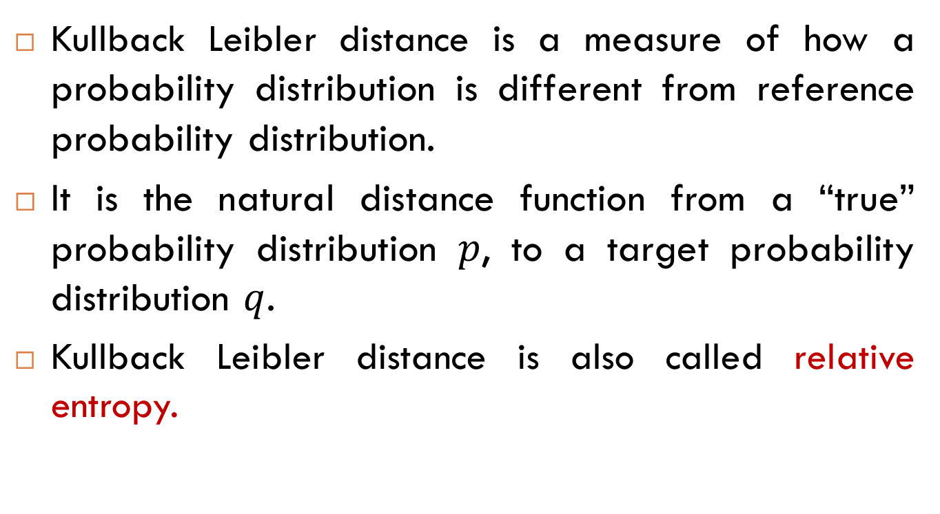
Kullback Leibler Distance
Kullback Leibler distance is a measure of how a probability distribution is different from reference probability distribution.
It is the natural distance function from a “true” probability distribution $p$, to a target probability distribution $q$.
Kullback Leibler distance is also called relative entropy.

Slide 4
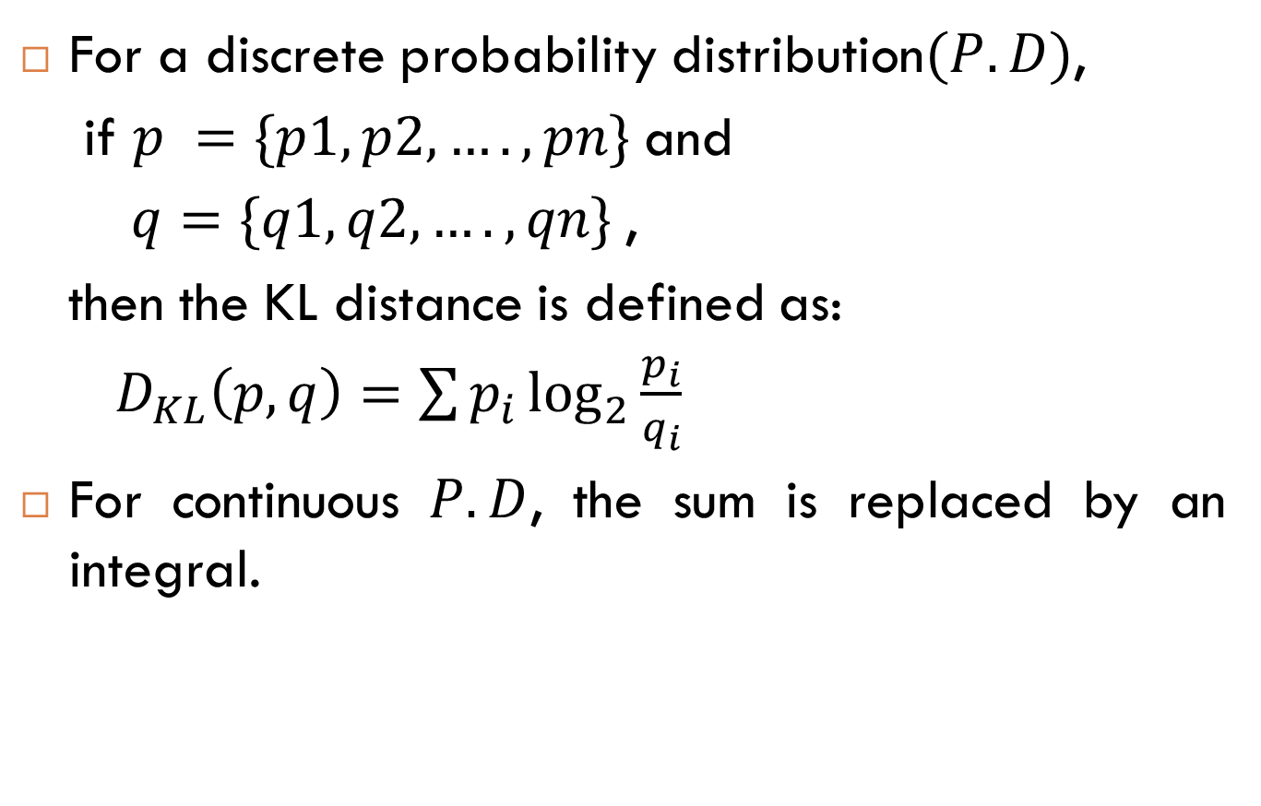
KL Distance
For a discrete probability distribution$(P.D)$,
if $p =\{p1,p2,….,pn\}$and
$q=\{q1,q2,….,qn\}$,
then the KL distance is defined as:
$D_{KL}\left(p,q\right)=\sum{p_{i}\log_{2}{\frac{p_{i}}{q_{i}}}}$
For continuous $P.D$, the sum is replaced by an integral.

Slide 5

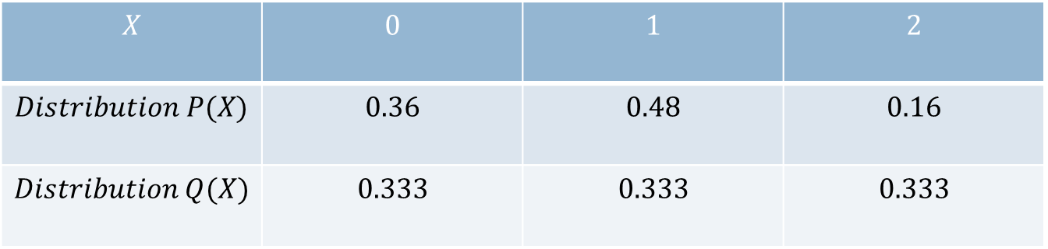
KL Distance: Example
$$X$$ | $$0$$ | $$1$$ | $$2$$
$$Distribution P(X)$$ | $$0.36$$ | $$0.48$$ | $$0.16$$
$$Distribution Q(X)$$ | $$0.333$$ | $$0.333$$ | $$0.333$$
The distribution $P(X)$ is a binomial distribution and
$Q(X)$ is a uniform distribution

Slide 6
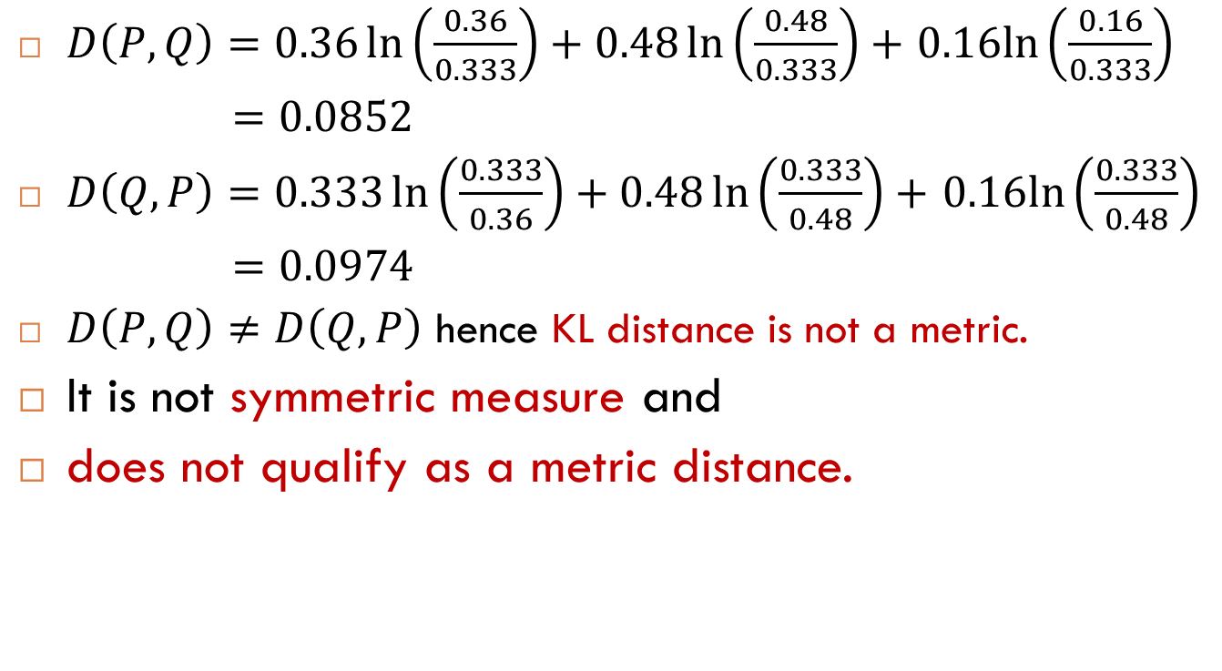
KL Distance: Is it Metric?
$D\left(P,Q\right)=0.36\ln\left(\frac{0.36}{0.333}\right)+0.48\ln\left(\frac{0.48}{0.333}\right)+$ $0.16ln⁡\left(\frac{0.16}{0.333}\right)$
$=0.0852$
$D\left(Q,P\right)=0.333\ln\left(\frac{0.333}{0.36}\right)+0.48\ln\left(\frac{0.333}{0.48}\right)+$ $0.16ln⁡\left(\frac{0.333}{0.48}\right)$
$=0.0974$
$D\left(P,Q\right)≠D\left(Q,P\right)$ hence KL distance is not a metric.
It is not symmetric measure and
does not qualify as a metric distance.

Slide 7
Bhattacharya Distance
Introduction
Example
Intuition

Slide 8
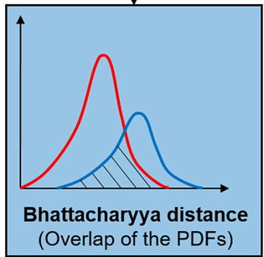
Bhattacharya Distance
It measures the similarity between two probability distributions.
It is used to compare two normalized histograms.
Bhattacharyya coefficient is an approximate measurement of two statistical distribution
The coefficient can be used to determine the relative closeness of the two samples

Slide 9
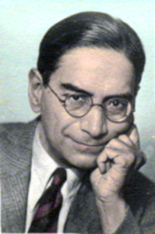
Bhattacharya Distance
Bhattacharyya Coefficient and Distance
Both measures are named after Anil Kumar Bhattacharya (professor in ISI Kolkata, 1930)
The Mahalanobis distance
It is a measure of the distance between a point P and a distribution D, introduced by PC Mahalanobis (Professor in ISI Kolkata, 1936)
PC Mahalanobis

Slide 10
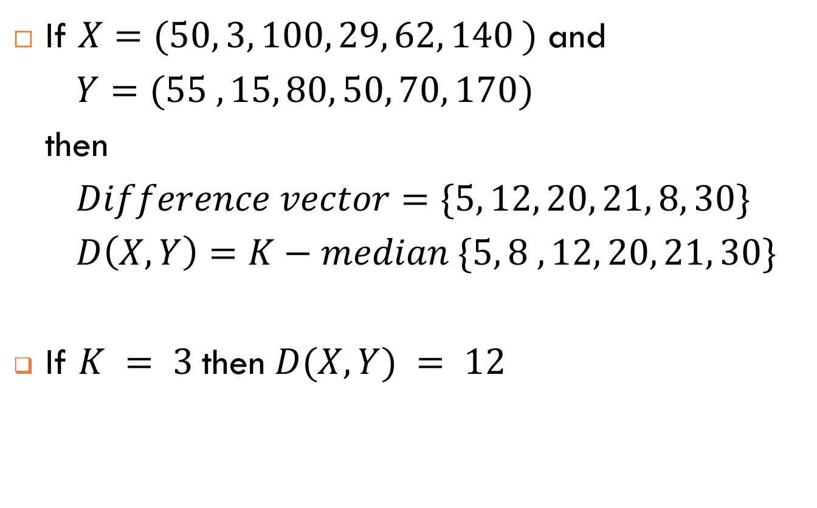
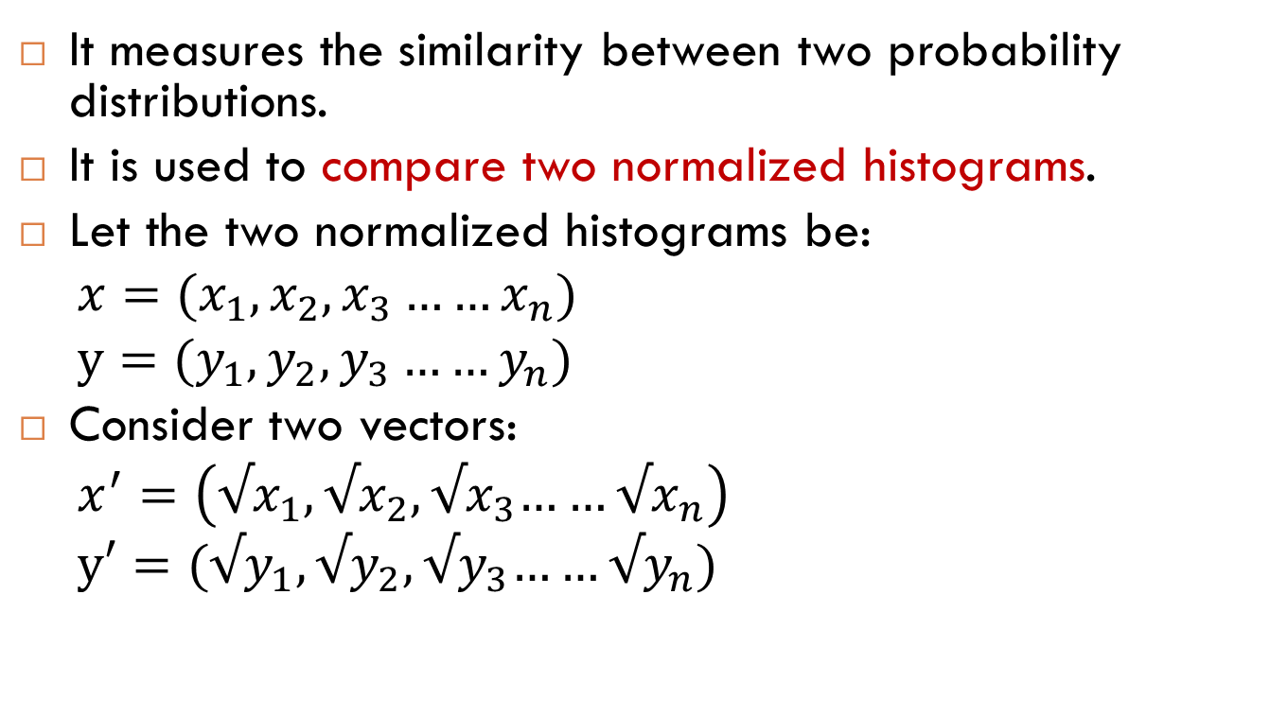
Bhattacharya Distance
It measures the similarity between two probability distributions.
It is used to compare two normalized histograms.
Let the two normalized histograms be:
$x=(x_{1},x_{2},x_{3}……x_{n})$
$y=(y_{1},y_{2},y_{3}……y_{n})$
Consider two vectors:
$x^{′}=\left(√x_{1},{√x}_{2},{√x}_{3}……√x_{n}\right)$
$y′=({√y}_{1},{√y}_{2},{√y}_{3}……{√y}_{n})$
$$−−−−Eqn 1$$

Slide 11
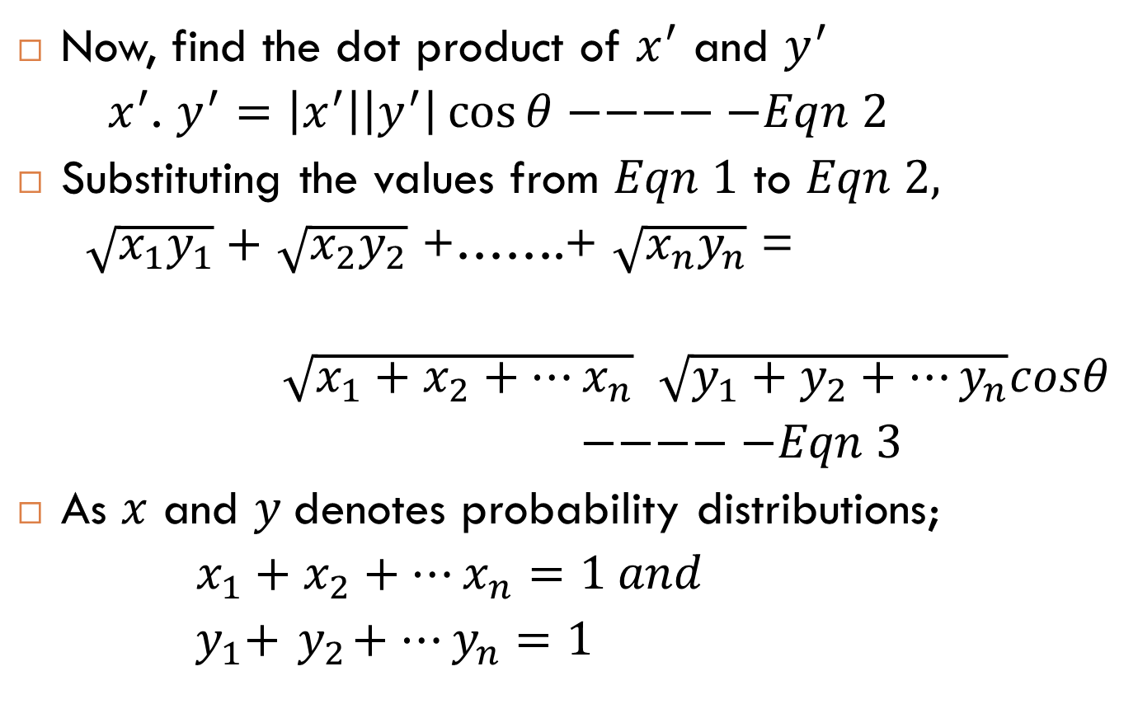
Bhattacharya Distance
Now, find the dot product of $x^{′}$ and $y^{′}$
${ x}^{′}$. $y^{′}=\left|x^{′}\right|\left|y^{′}\right|\cos{θ}−−−−−Eqn 2$
Substituting the values from $Eqn 1$ to $Eqn 2,$
$\sqrt{x_{1}y_{1}}+$ $\sqrt{x_{2}y_{2}}$ +…….+ $\sqrt{x_{n}y_{n}}$ =
$\sqrt{x_{1}+x_{2}+…x_{n}}$ $\sqrt{y_{1}+y_{2}+…y_{n}}cosθ$
$−−−−−Eqn 3$
As $x$ and $y$denotes probability distributions;
$x_{1}+x_{2}+…x_{n}=1 and$
${ y}_{1}+{ y}_{2}+…y_{n}=1$

Slide 12
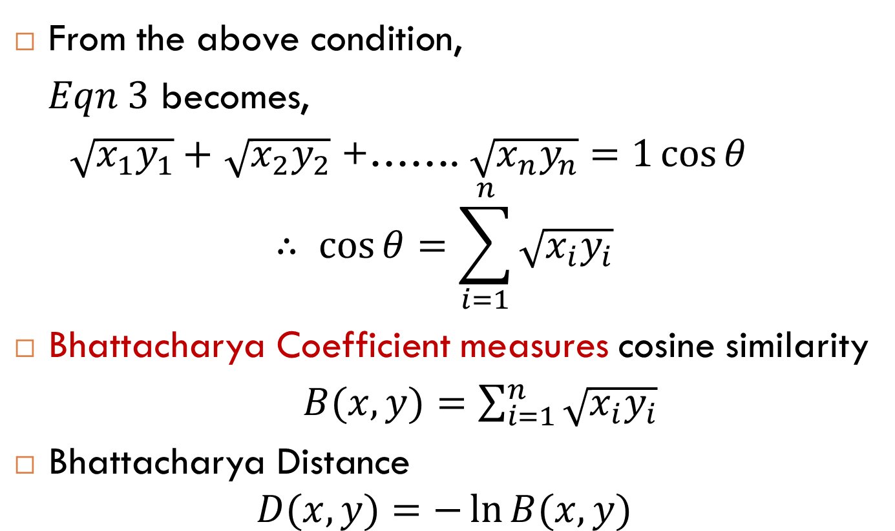
Bhattacharya Distance
From the above condition,
$Eqn 3$ becomes,
$\sqrt{x_{1}y_{1}}+$ $\sqrt{x_{2}y_{2}}$ +……. $\sqrt{x_{n}y_{n}}=1\cos{θ}$
$$∴ \cos{θ=\sum_{i=1}^{n}{\sqrt{x_{i}y_{i}}}}$$
Bhattacharya Coefficient measures cosine similarity
$B(x,y){=\sum_{i=1}^{n}{\sqrt{x_{i}y_{i}}}}$
Bhattacharya Distance
$$D(x,y){=−\ln{B(x,y)}}$$

Slide 13
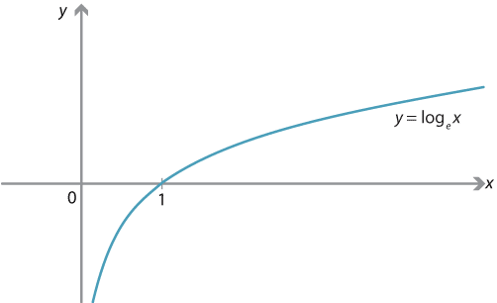
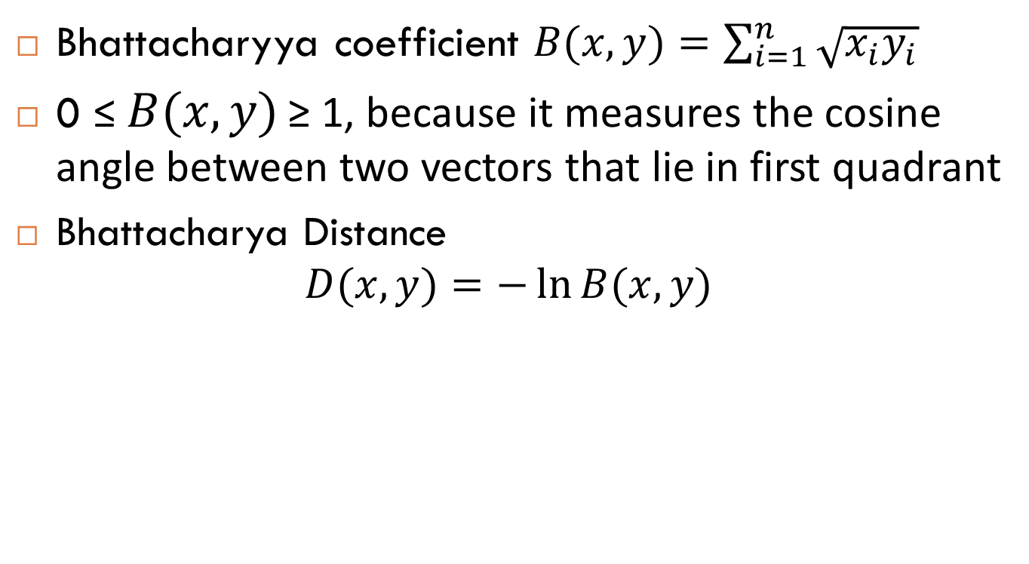
Bhattacharya Distance
Bhattacharyya coefficient $B(x,y){=\sum_{i=1}^{n}{\sqrt{x_{i}y_{i}}}}$
0 ≤ $B(x,y)$ ≥ 1, because it measures the cosine angle between two vectors that lie in first quadrant
Bhattacharya Distance
$$D(x,y){=−\ln{B(x,y)}}$$

Slide 14
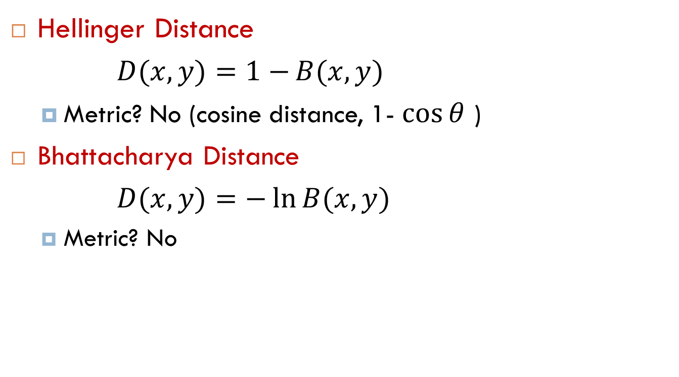
Bhattacharya Distance
Hellinger Distance
$D(x,y){=1−{B(x,y)}}$
Metric? No (cosine distance, 1- $\cos{θ}$ )
Bhattacharya Distance
$D(x,y){=−\ln{B(x,y)}}$
Metric? No

Slide 15
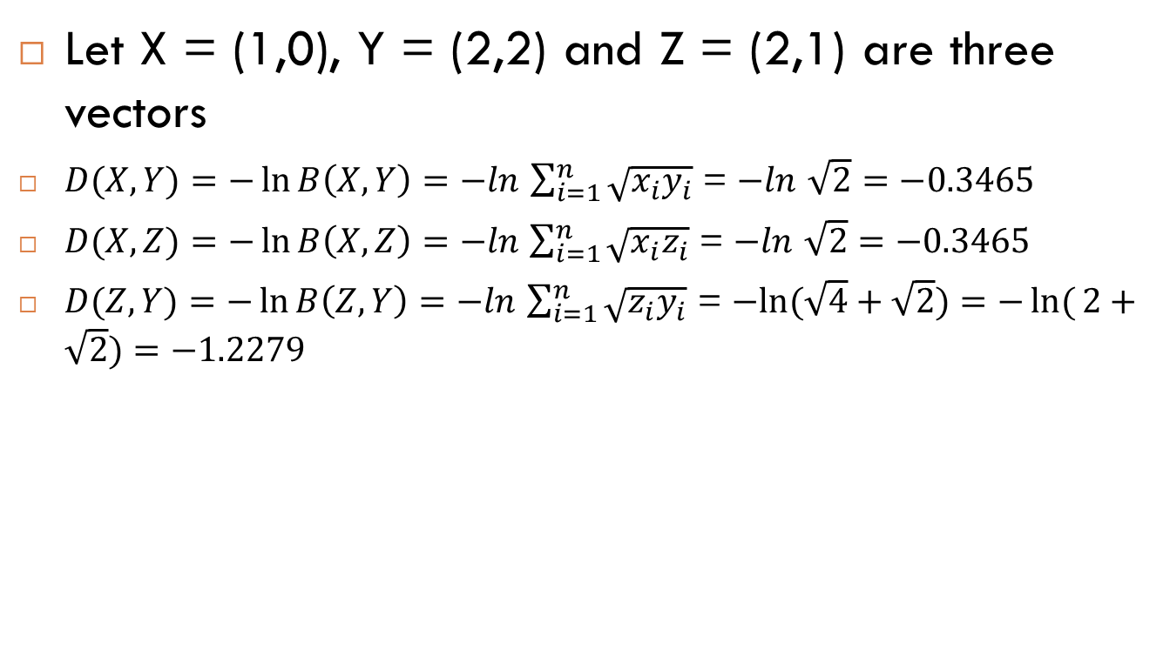
Bhattacharya Distance: It is Metric?
Let X = (1,0), Y = (2,2) and Z = (2,1) are three vectors
$D(X,Y){=−\ln{B\left(X,Y\right)=−ln}}$ $\sum_{i=1}^{n}{\sqrt{x_{i}y_{i}}}$ = $−ln$ $\sqrt{2}=−0.3465$
$D(X,Z){=−\ln{B\left(X,Z\right)=−ln}}$ $\sum_{i=1}^{n}{\sqrt{x_{i}z_{i}}}$ = $−ln$ $\sqrt{2}=−0.3465$
$D(Z,Y){=−\ln{B\left(Z,Y\right)=−ln}}$ $\sum_{i=1}^{n}{\sqrt{z_{i}y_{i}}}$ = $−ln⁡(\sqrt{4}+\sqrt{2})=−\ln{(}2+\sqrt{2})=−1.2279$

Slide 16

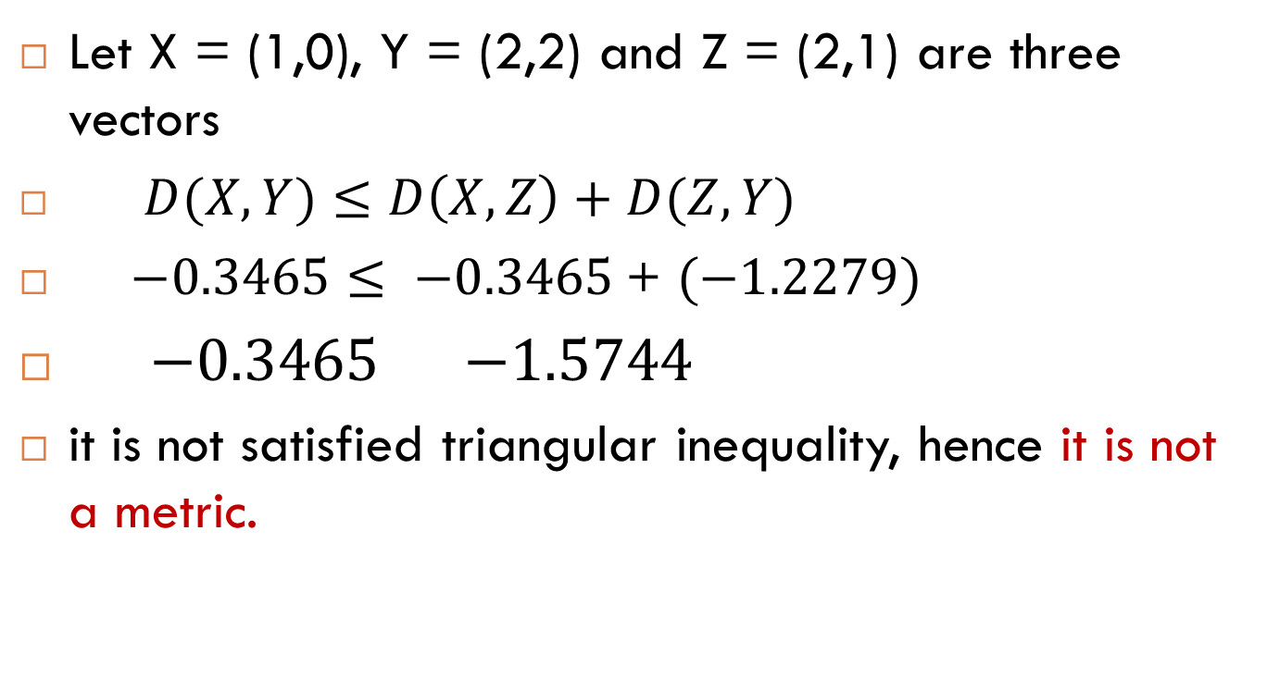
Bhattacharya Distance: It is Metric?
Let X = (1,0), Y = (2,2) and Z = (2,1) are three vectors
$D(X,Y){≤D\left(X,Z\right)+D(Z,Y)}$
$−0.3465$ $≤ −0.3465$+ $(−1.2279)$
$−0.3465$ $−1.5744$
it is not satisfied triangular inequality, hence it is not a metric.

Slide 17
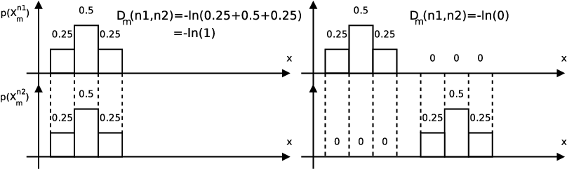
Intuition

Slide 18
Summary
KL distance with example
Bhattacharya Distance

Slide 19
Thank you

